Slide 1
Project Pebbles & Bowls
David Wullimann & Ingrid Berggren

Slide 2
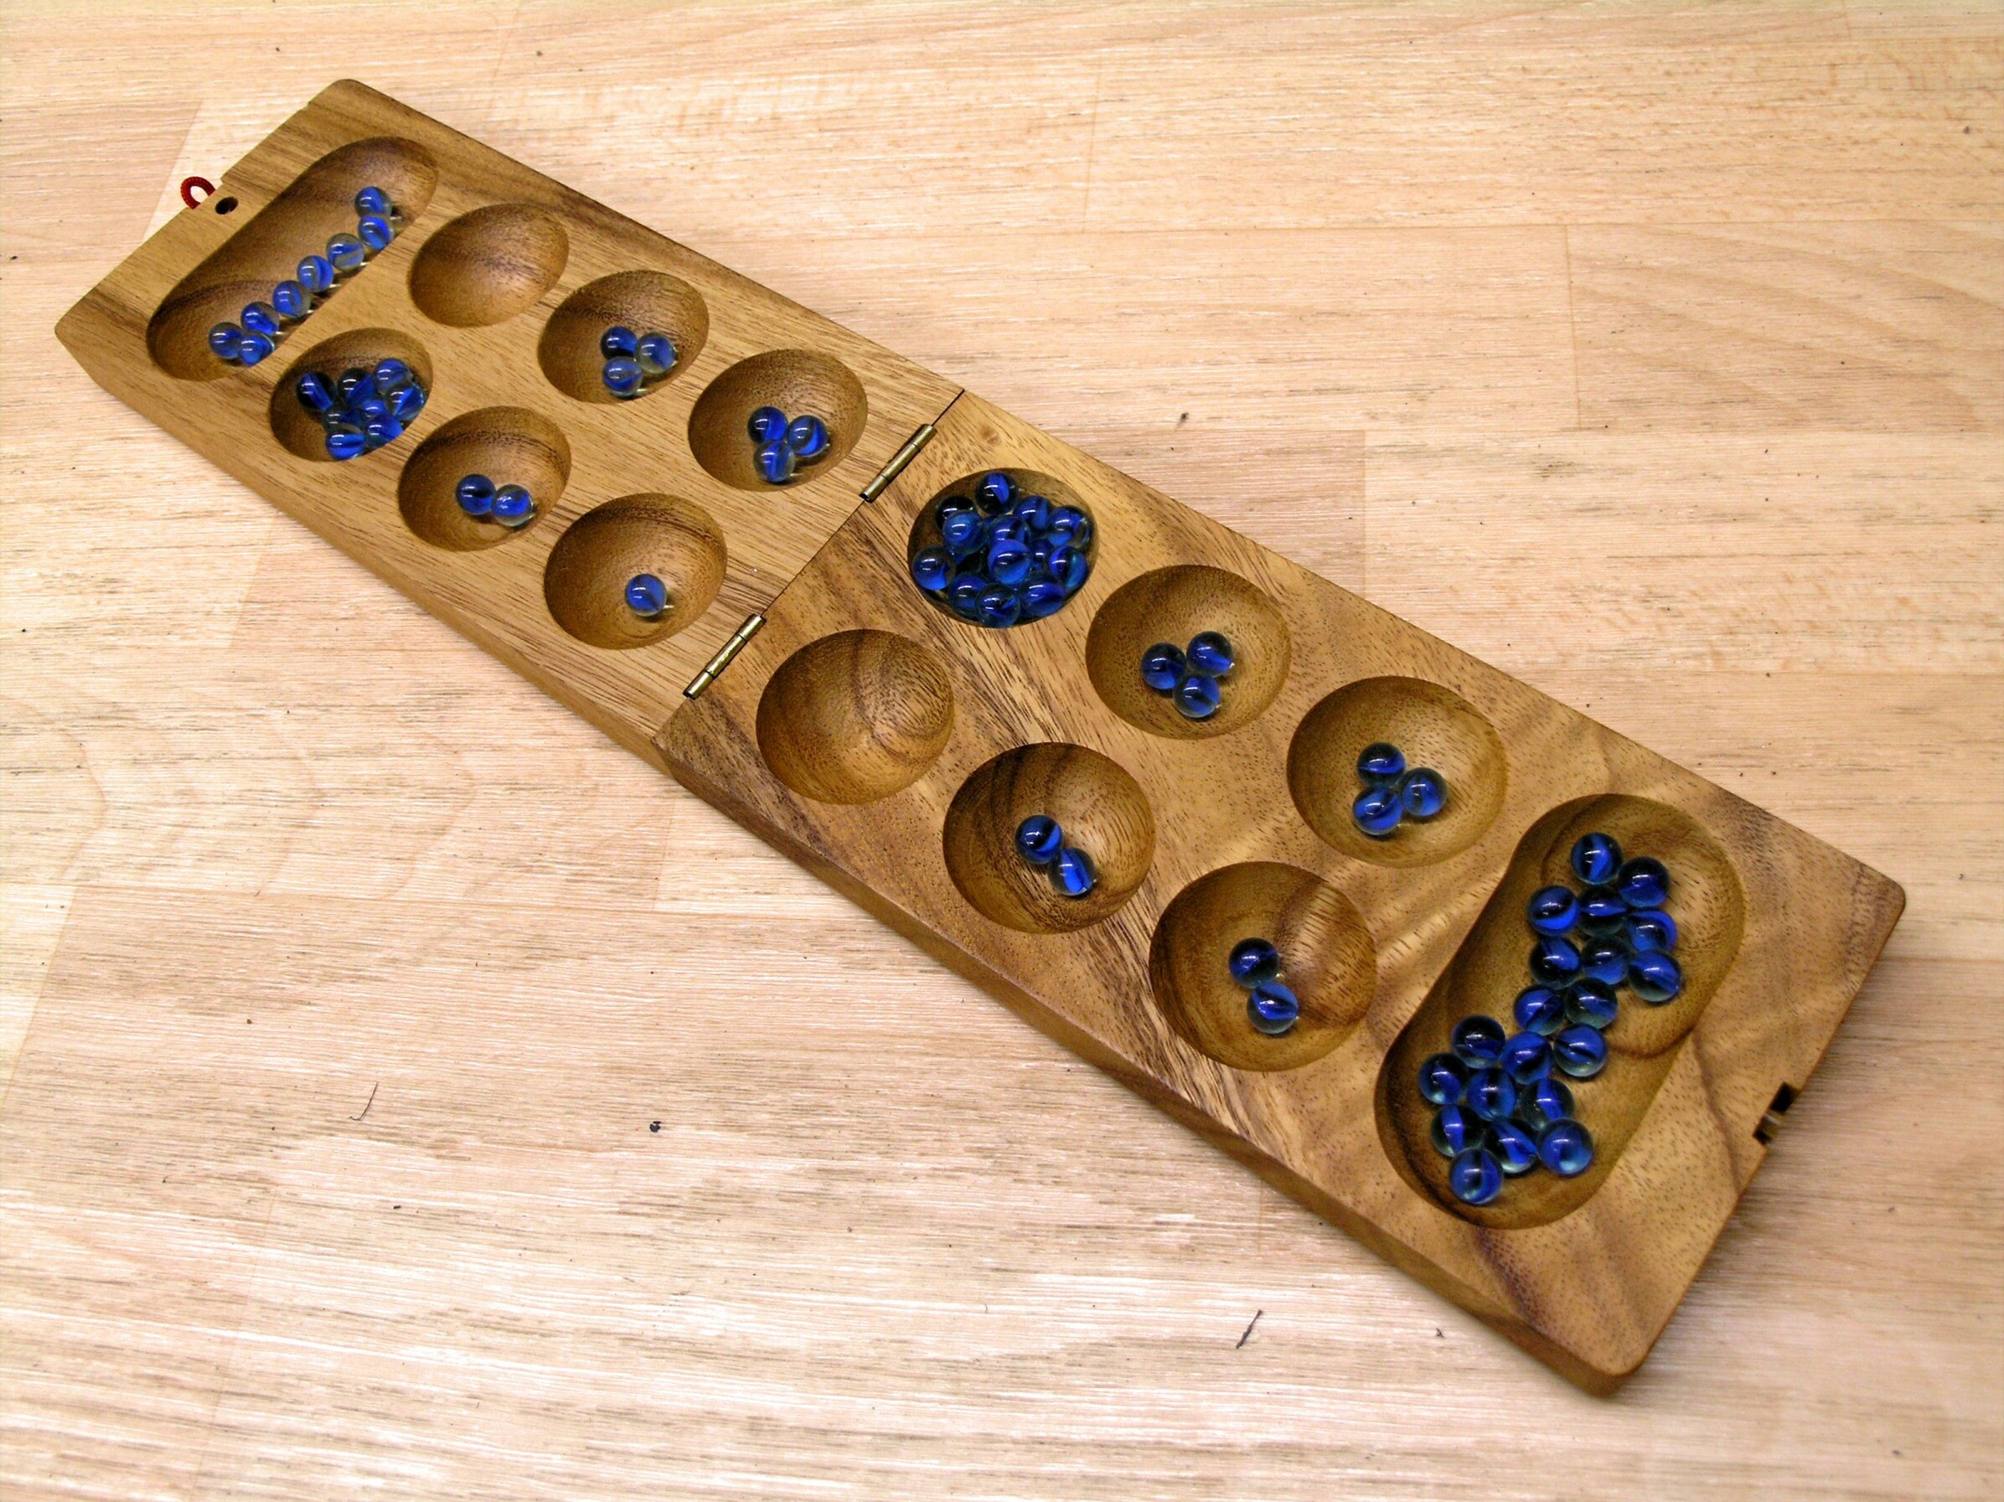
The game
Kalah or Mancala
Ancient Egypt!
All you need is a bowls, pebbles and two players!

Slide 3
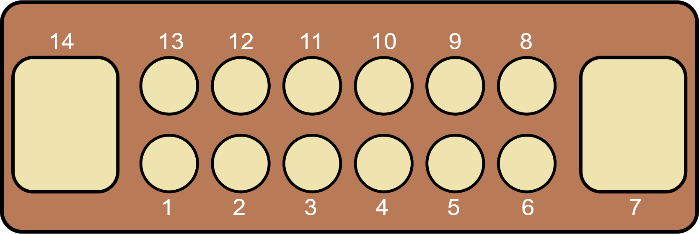
The game
Each player has 6 bowls and 1 nest

Slide 4
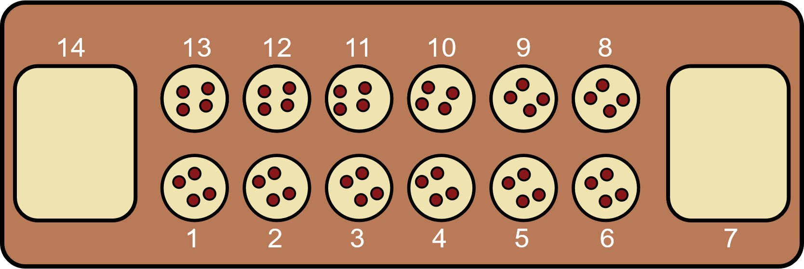
The game
There are 74 pebbles in total
Each player has 4 pebbles in each bowl
Each player takes turns moving the pebbles
# of pebbles in the bowl is the # of moves

Slide 5
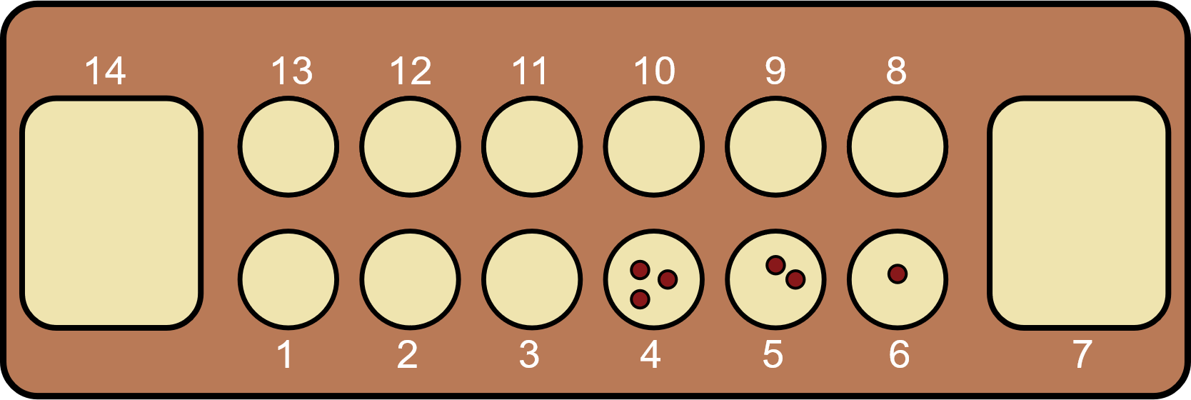
The game
If the last pebble in your nest → your turn again

Slide 6
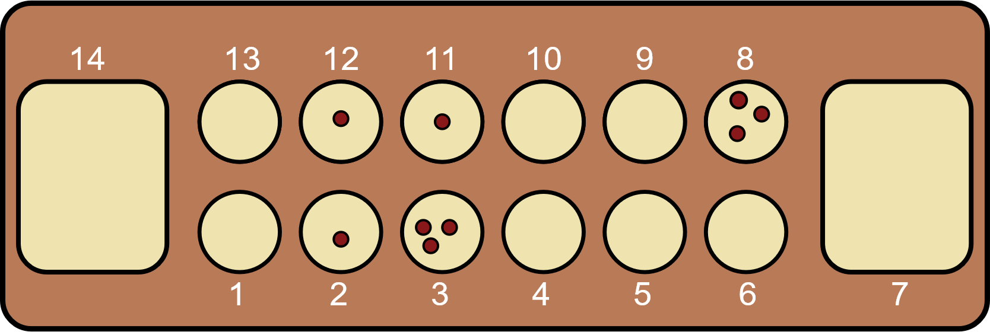
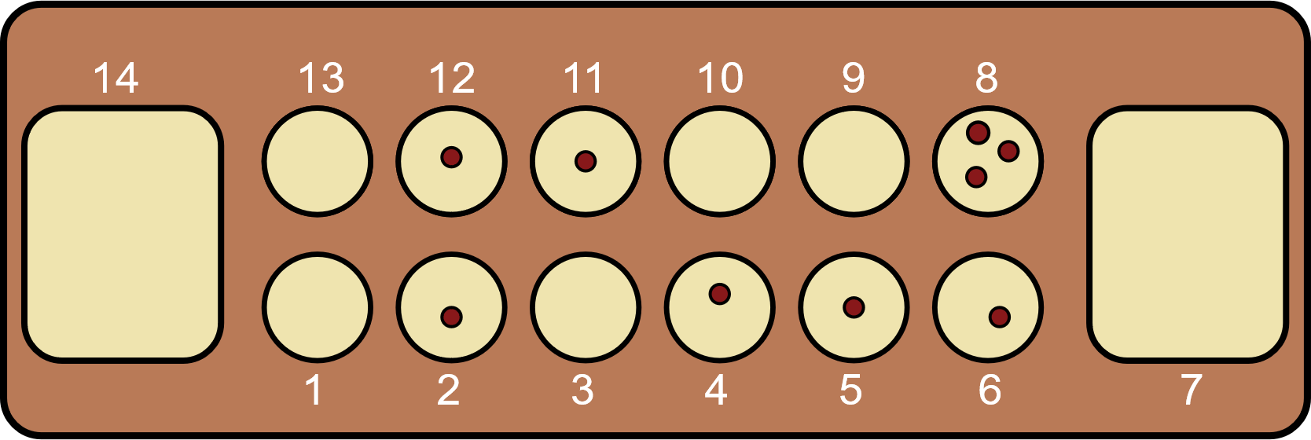
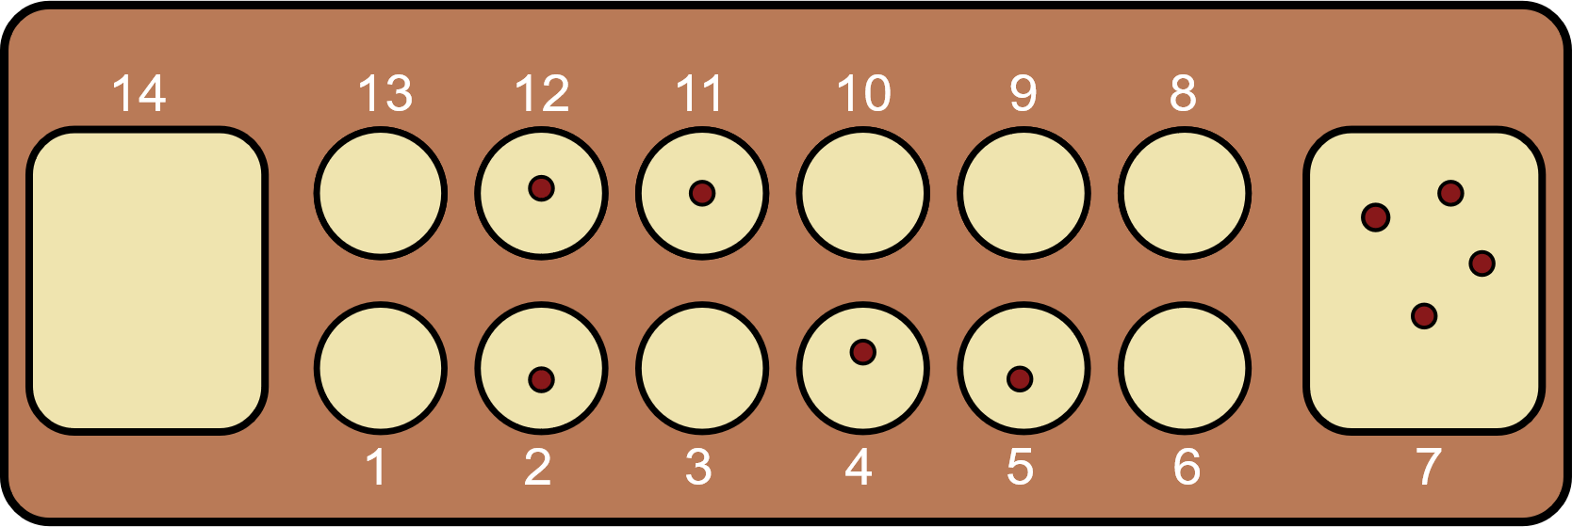
The game
Player 1 takes from bowl 3
Player can steal from the other player’s bowl and get all pebbles in both bowl’s added to the nest!

Slide 7
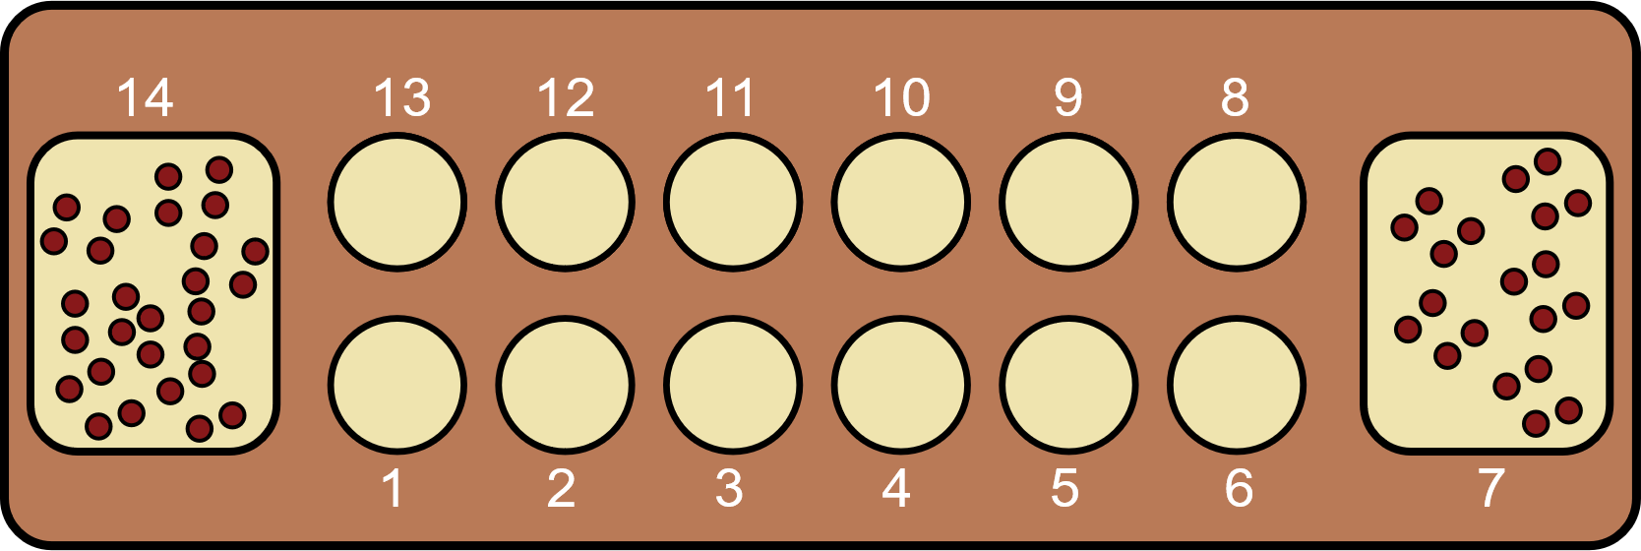
The game
Game is over when all bowls are empty
The winner is the one with the highest number of pebbles in their nest!

Slide 8
Demo!

Slide 9
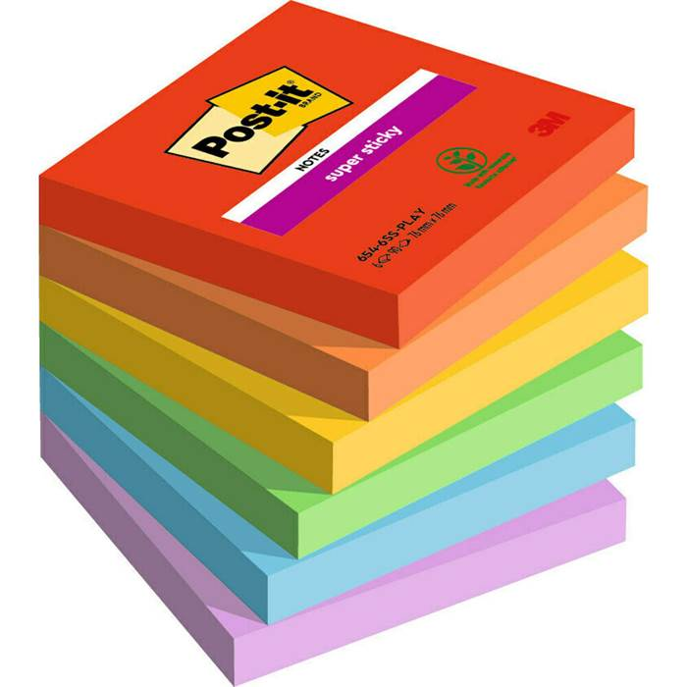
What went well
Discuss everything out loud to each other
It helped to switch coder so that the code made more sense
Visualisation helps! Drawing and post-it notes Have an easy to read code-doc

Slide 10
Challenges
Writing functions that follow the flow of the game and keeping the rule
While loop was difficult but:
Start with the loop structure
It helped to add one function at a time
print() statements at each step!

Slide 11
Future improvements
Better user experience (graphics etc.)
Make comments while writing functions
Always make docstrings for all the functions

